Slide 1
Diamond prices prediction
Machine learning project by team 4 :
Kinan hasan - ahmad nader
abd-allah khfagi - abd-alrahman alsahy

Slide 2
with 11 features describing diamonds
We need to predict the price based on the features .

Slide 3
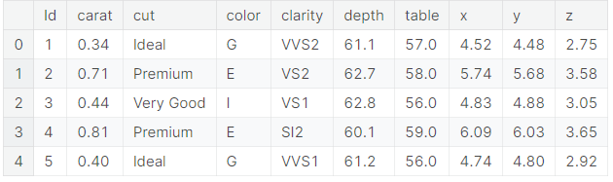
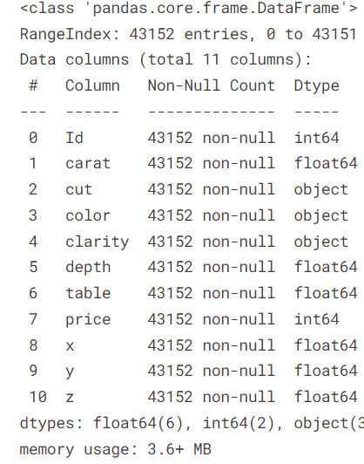
We have got :
3 Categorical columns
8 Numerical columns

Slide 4
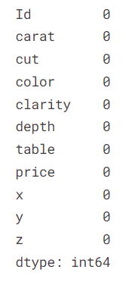
No Null values ☺

Slide 5
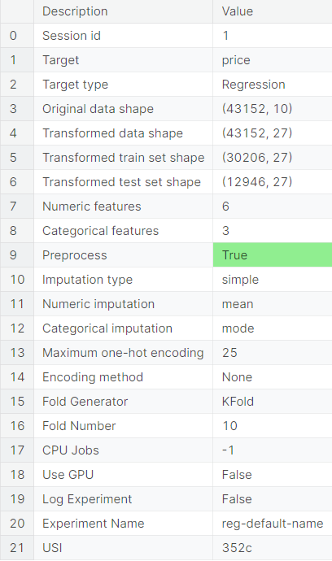
Using pycaret I tried to build abase model for further comparisons using pycaret do all the work for me like Encoding categorical features, splitting the data into train and test , and using kfold cross validation to make sure of precise evaluation ,

Slide 6
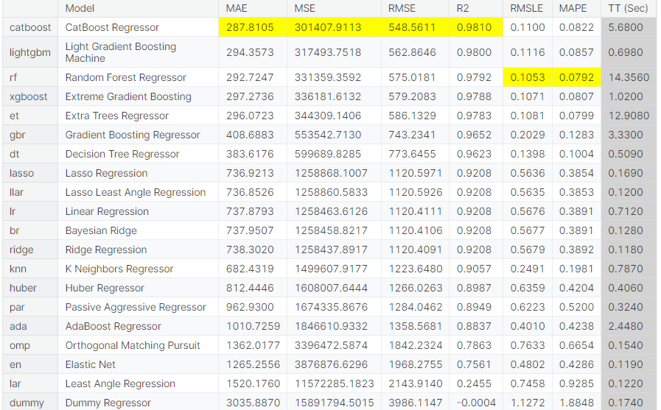
Using compare model () function pycaret compare all classification models and displays all evaluation metrics scores for each model so I can see which model is the best one

Slide 7
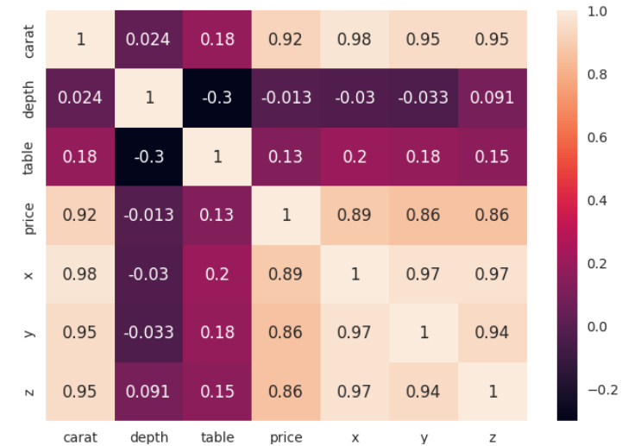
After dropping the ‘id’ colomns
We checked the correlation
Between the features so noticed that the colomns ‘x’ , ‘y’ and ‘z’
Have strong correlation so we dropped the columns ‘y’ and ‘z’.

Slide 8
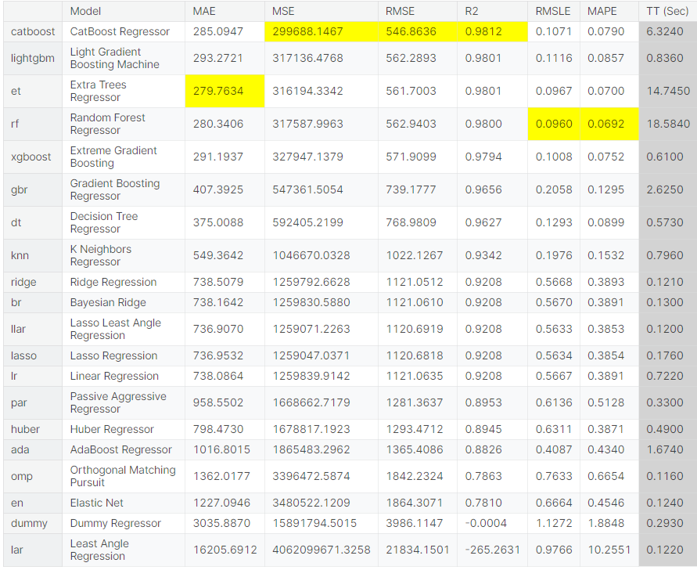
After dropping high colinarity cols we notice that the model rmse decreased witch a good sign that we are on the right track

Slide 9
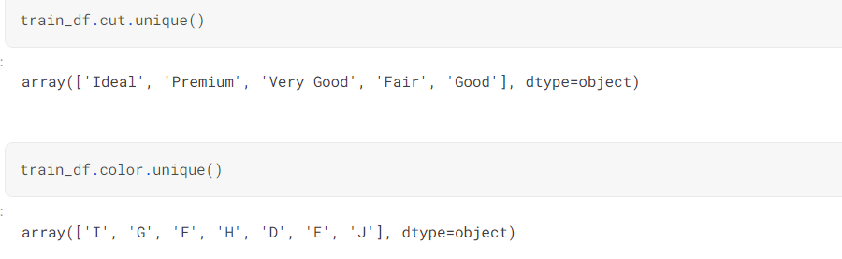
As you can see there are 5 categories in ‘cut’ column
And 7 in ‘color’ column .

Slide 10
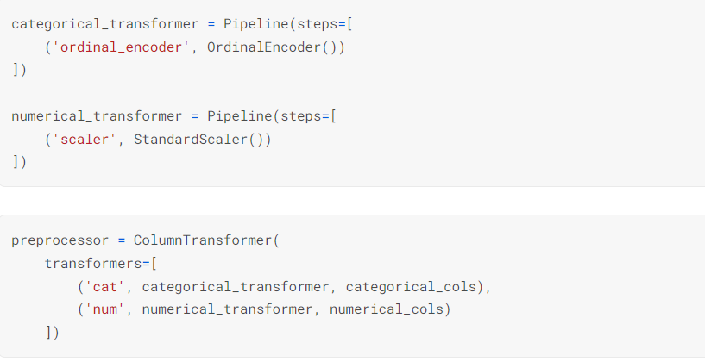
So we decided to do the encoding and scaling manually to see if it will make any difference

Slide 11
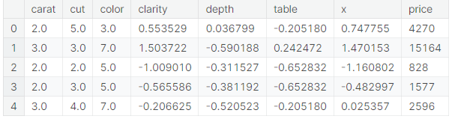
Categorical columns turned into numerical columns

Slide 12
But we still got almost the same numbers

Slide 13
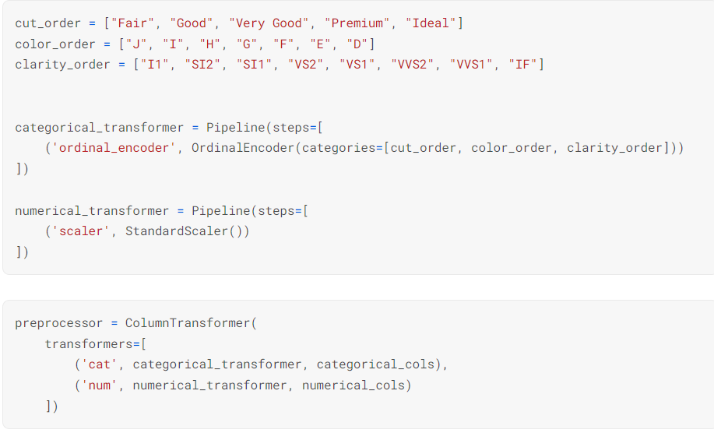
So what about passing the specific order of cols to ordinal encoder is that will make the difference

Slide 14
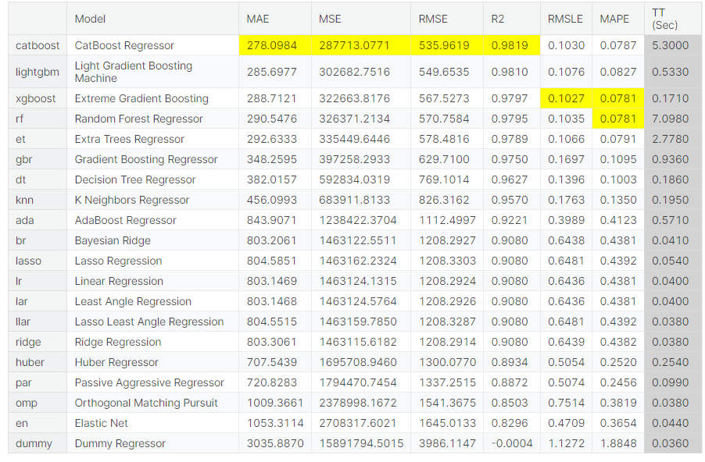
Yes it is we got a better model after using colmns orders

